Slide 1


NFL Offensive Stats: Passing is winning
Group 4
Trey griffin David (Manny) Cook-Francis Grant Grossman Aakash Rahman David Debrowski Michael Peyser

Slide 2
The Theme
Since 2008, the NFL has seen a dramatic increase in the amount of offensive productive production, primarily in the area of passing yards. Our contention is that this offensive explosion in passing has led directly to the emergence of “pass first” offenses & has forever changed the way the game is played.
Notes:
David Debrowski

Slide 3
The Coding Approach
Python for data import and munging
Mongos as our primary db tool
Flask for our webpage
Html for style
Javascript/d3/plotly for graphes
Greensock for animations
Notes:
Manny

Slide 4
Data Merging Techniques
Data pulled from an API using python
Cleaned in python into 3 separate dfs (offense, defense, and misc)
Imported into mongo
Notes:
Michael Peyser

Slide 5
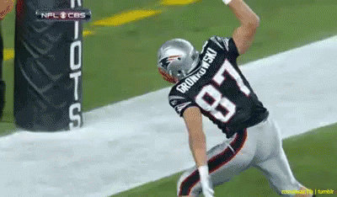
The Visuals
https://nflproject.herokuapp.com/plots
Visualizations were built using Plotly for simple line graphs and D3 JS for our interactive visualization.
GreenSock Animation Platform powered our animations (including our lovely spinning graph).
Built an easily replicable D3 circular barchart using a function.
Notes:
Aakash

Slide 6

Conclusions - Statistics from 2002-2019 suggest a direct correlation between an increase in passing yards & the total number of touchdowns scored. - During that same time period, rushing yardage has varied wildly, this has had little impact on the explosiveness of offense - Nearly all significant yardage stats have increased year over year since 2002.
Notes:
Grant
1.) The statistics from 2002-2019 show that an increase in passing yards also led to additional success in offensive production with an increase in passing touchdowns over that same period.

Slide 7
Let’s look at what we built
Notes:
Trey (I’ll do the entire site walkthrough and we can answer any questions as they arise)

Slide 8
Questions?
Notes:
Everyone

